Slide 1
SENG2260 Human-Computer Interaction
Week 5: Affective Aspects & International User Interfaces
All images in this presentation are either licenced or labelled for reuse on Google Images.

Slide 2
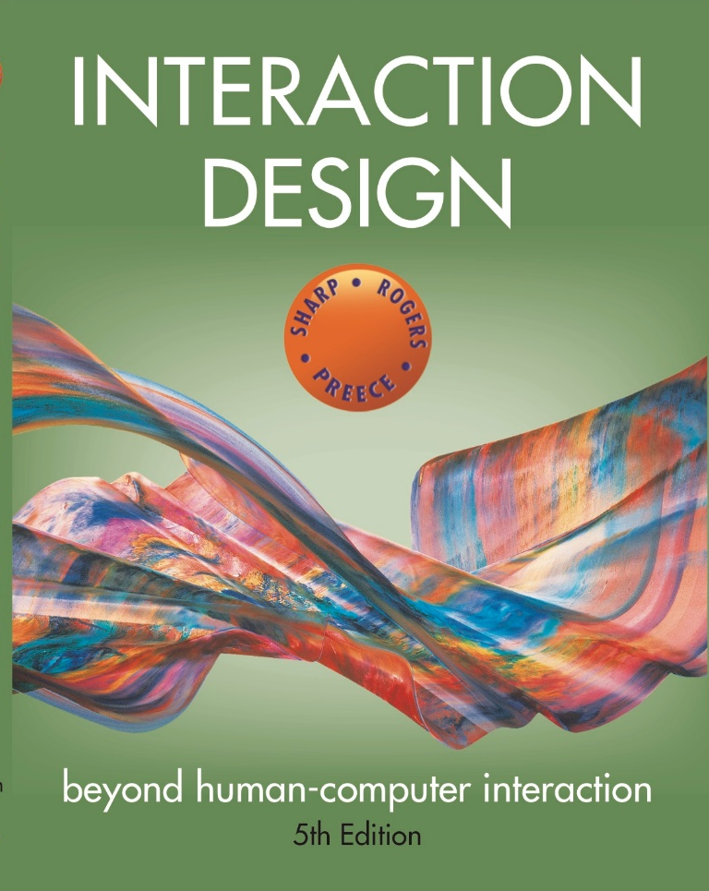
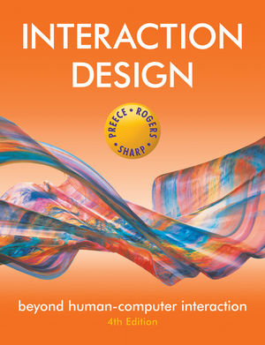
Chapter 6
EMOTIONAL
INTERACTION
Chapter 5
EMOTIONAL
INTERACTION

Slide 3
Overview
Emotions and the user experience
Expressive and emotional design
how the ‘appearance’ of an interface can affect users
Affective computing and emotional AI
Persuasive technologies and behavioural change
Anthropomorphism
the pros and cons
Notes:
3

Slide 4
Emotions and the user experience
HCI has traditionally been about designing efficient and effective systems
Now more about how to design interactive systems that make people respond in certain ways
e.g. to be happy, to be trusting, to learn, to be motivated
Emotional interaction is concerned with how we feel and react when interacting with technologies
Affective computing is improving with better recognition software and machine learning algorithms
Notes:
4

Slide 5
Emotional interaction
What makes us happy, sad, annoyed, anxious, frustrated, motivated, delirious and so on
translating this into different aspects of the user experience
Why people become emotionally attached to certain products (e.g. virtual pets)
Can social robots help reduce loneliness and improve wellbeing?
How to change human behaviour through the use of emotive feedback
Notes:
Emotional interaction is about considering what makes us happy, sad, annoyed, anxious, frustrated, motivated, delirious and so on and translating this knowledge into different aspects of the user experience, from when we first want something to when we no longer interact with it or need to replace it. However, it is not straightforward to achieve as people’s moods and feelings are constantly changing. There are also many reasons that might cause someone to be happy or sad, such as the sun shining or someone else winning a game.
5

Slide 6
Activity
Try to remember the emotions you went through when buying a big ticket item online (e.g. a fridge, a vacation, a computer)
How many different emotions did you go through?
Notes:
Consider the different emotions you experience for a common everyday activity – shopping online for a product, such as a new phone, a washing machine or a vacation. Firstly, there is the realisation of needing or wanting it, and then the desire and anticipation of purchasing it. This is followed by the joy or frustration of finding out more about what products are available and deciding which to choose from potentially hundreds or even thousands (by visiting numerous websites, such as comparison sites, reviews, recommendations, blogs). This entails matching what is available with what you like or need and if you can afford it. The thrill of deciding on a purchase may be quickly followed by the shock of how much it costs and the disappointment that you can’t afford it. The process of having to decide again may be accompanied by annoyance as you cant find one that is as good as your first choice. You think about other options, such as seeking advice from an expert in a shopping mall, but you have an aversion to sales assistants and don’t trust their advice, because you think they have their own interests (making money), rather than yours, at heart. So you carry on looking, getting more tired and frustrated. When you do make a decision you experience a sense of relief. You click merrily though the various options (such as color, size, warranty) and then the dreaded online payment form pops up. You type in all your details and press the final payment button. A window then appears saying that your credit card number is incorrect. So you type it in again very slowly. And you notice you need to type the 3 number security code in again. Finally, when all is done you let out a big sigh. But as you walk away from your computer doubts start to form in your mind – maybe you should have bought the other one...
This rollercoaster set of emotions is what many of us experience when shopping online, especially for expensive products, where there are a myriad of options to choose from and where we want to be sure that we make the right choice.
6

Slide 7
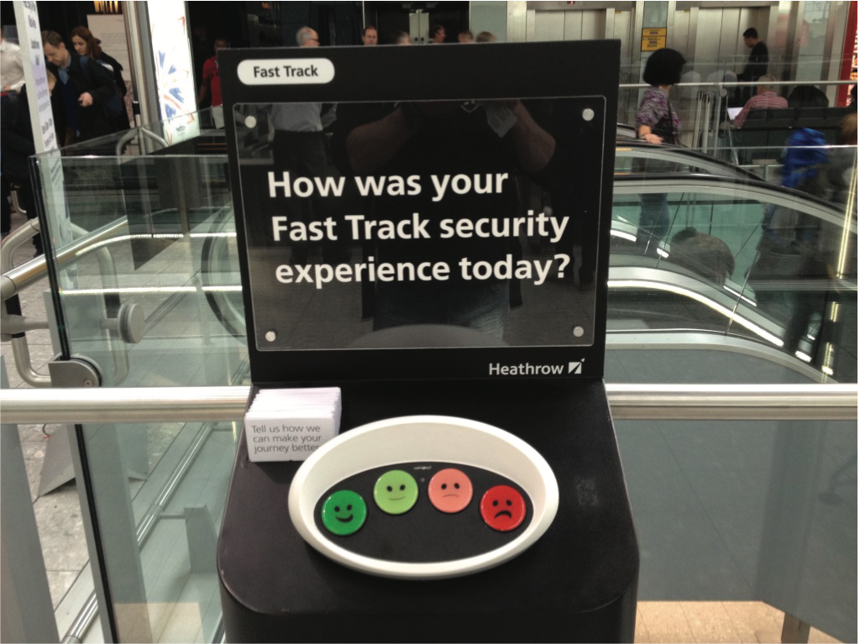
Why has this simple way of obtaining visitor feedback been so effective?

Slide 8
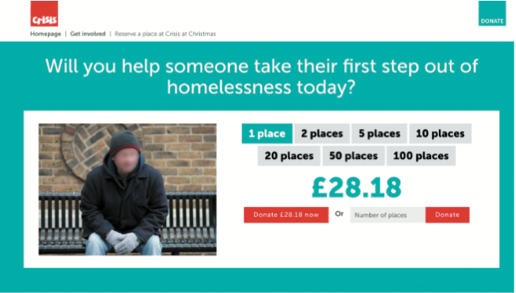
Pulling at the heart strings with emotive message

Slide 9
How easy is it to design an interface to match or change how we are feeling?
Should an interface be designed to improve how we feel?
If so how?
Our moods and feelings are continuously changing
How does the interface keep track and know when to do something?
What moods match which kinds of interfaces?
How would you design an interface for when someone is happy, angry, sad, bored, focused?

Slide 10
How do emotions affect behavior and behavior emotions?
Examine how people express themselves and read each other (emotional intelligence)
understand relationship between facial expressions, body language, gestures and tone of voice, e.g.
when people are happy they laugh and relax body posture
when they are angry they screw up their face
Does being angry make you concentrate better or more distracted?
When you are happy do you take more risks such as spend more money or buy more?
Baumeister et al (2007) argue the relationship is more complex than a single cause-and-effect model

Slide 11
Automatic (affect) versus conscious emotions
Emotions can be short-lived (e.g. fit of anger) or complex and long-lasting (e.g. jealousy)
Have been categorized as automatic or conscious
Automatic ones are rapid and dissipate quickly
Conscious ones develop slowly and take a long time to go (e.g. reflection)

Slide 12
Ortony et al (2005) model of emotional design

Slide 13
Claims from model
Our emotional state changes how we think
when frightened or angry we focus narrowly and body responds by tensing muscles and sweating
more likely to be less tolerant
when happy we are less focused and the body relaxes
More likely to overlook minor problems and be more creative
Notes:
13

Slide 14
Designing with the three levels in mind
Visceral design refers o making products look, feel and sound good
Behavioral design is about use and equates with traditional values of usability
Reflective design is about considering the meaning and personal value of a product

Slide 15
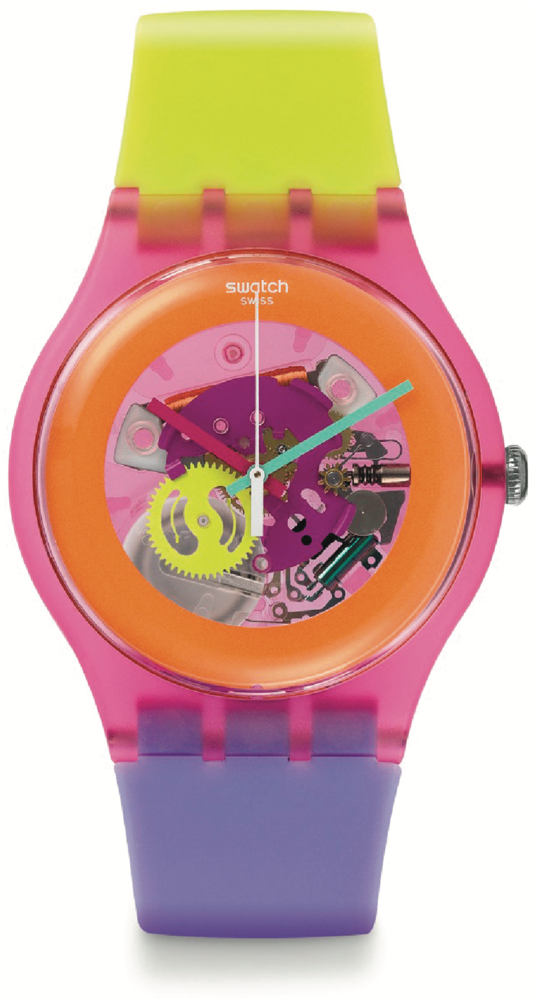
Analyzing a swatch watch design using the model
Cultural images and graphical elements designed at reflective level
Affordances of use at behavioral level
Brilliant colors and wild design attract user’s attention at visceral level

Slide 16


Expressive interfaces
Provide reassuring feedback that can be both informative and fun
But can also be intrusive, causing people to get annoyed and even angry
Colour, icons, sounds, graphical elements and animations are used to make the ‘look and feel’ of an interface appealing
conveys an emotional state
In turn this can affect the usability of an interface
people are prepared to put up with certain aspects of an interface (e.g. slow download rate) if the end result is appealing and aesthetic
Notes:
16

Slide 17
The appearance of an interface
(a) Emotional icons were used in the 80s to indicate rebooting or crashed
smiling apple face
(b) Nowadays use more impersonal but aesthetically pleasing icons to indicate user needs to wait
the beach ball

Slide 18
The design of thermostats
(a) The Nest has a minimalist and aesthetically pleasing design
Round face and simple dial
Large font and numbers
(b) Very different from earlier thermostat designs
utilitarian and dull

Slide 19
Annoying interfaces
Microsoft pioneered friendly interfaces for technophobes
e.g. ‘At home with Bob’ software
3D metaphors based on familiar places (e.g. living rooms)
Agents in the guise of pets (e.g. bunny, dog) were included to talk to the user
Make users feel more at ease and comfortable
But many people did not like the idea of Bob so never made it to product
Notes:
19

Slide 20
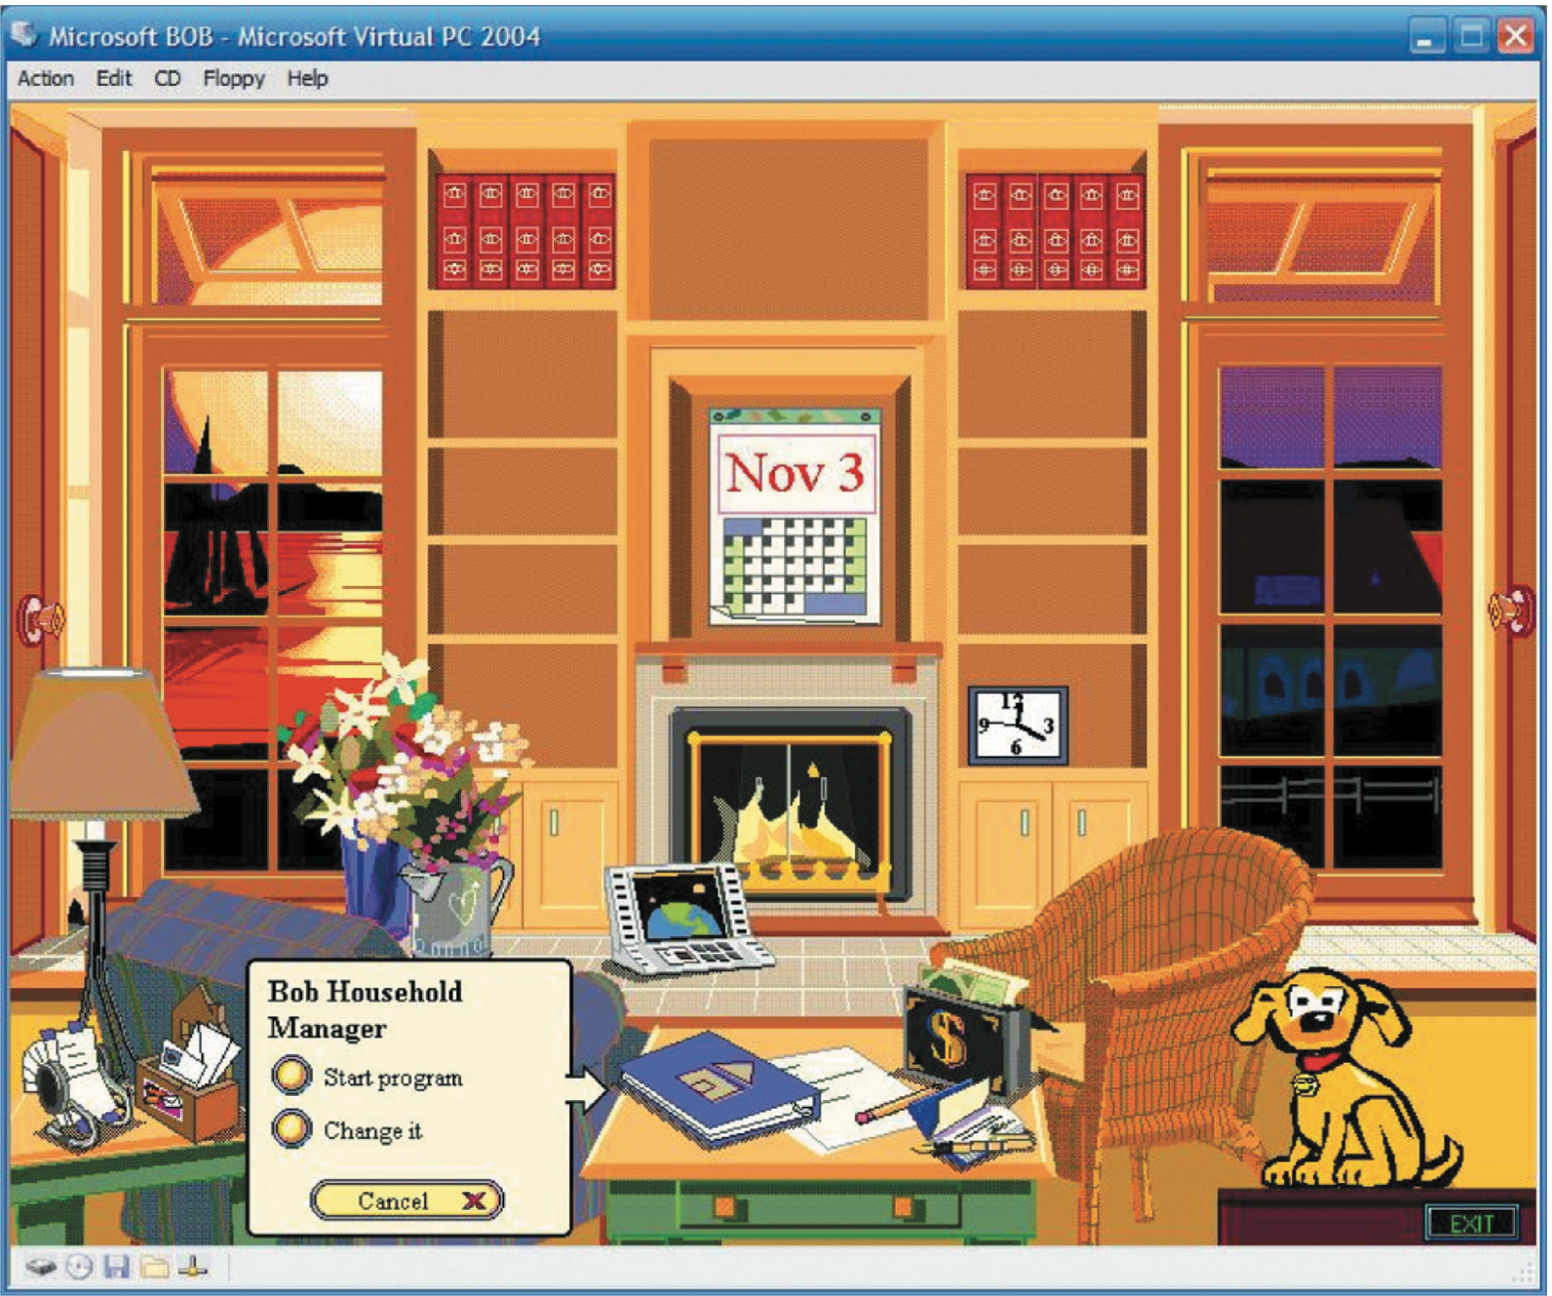
At home with Bob
Notes:
20

Slide 21
Microsoft’s Clippy and IKEA’s Anna
Clippy did…
But was disliked by so many?
Was it annoying, distracting, patronising or other?
Anna appeared as a virtual agent
Blinked, moved her lips and head to suggest facial expressions
Notes:
21

Slide 22
Frustrating interfaces
Many causes:
When an application doesn't work properly or crashes
When a system doesn't do what the user wants it to do
When a user’s expectations are not met
When a system does not provide sufficient information to enable the user to know what to do
When error messages pop up that are vague, obtuse or condemning
When the appearance of an interface is garish, noisy, gimmicky or patronizing
When a system requires users to carry out too many steps to perform a task, only to discover a mistake was made earlier and they need to start all over again
Notes:
22

Slide 23
Error messages
“The application Word Wonder has unexpectedly quit due to a type 2 error.”
Why not instead:
“the application has expectedly quit due to poor coding in the operating system”
Shneiderman’s classic guidelines for error messages include:
avoid using terms like FATAL, INVALID, BAD
Audio warnings
Avoid UPPERCASE and long code numbers
Messages should be precise rather than vague
Provide context-sensitive help
Notes:
23

Slide 24

A friendly cute image instead of the impersonal 404 error message
Notes:
24
Can you change to Figure 5.8

Slide 25
Dilemma: Should computers say they’re sorry?
Reeves and Naas (1996) argue that computers should be made to apologize
Should emulate human etiquette
Would users be as forgiving of computers saying sorry as people are of each other when saying sorry?
How sincere would they think the computer was being? For example, after a system crash:
“I’m really sorry I crashed. I’ll try not to do it again”
How else should computers communicate with users?
Notes:
25

Slide 26
Dilemma: Should Voice assistants teach kids good manners?
Many children talk to Alexa as if she was their friend
They also learn that it is not necessary to say please and thank you to her when asking questions
Is this lack of using etiquette a problem?
Would it transfer over to real life situations?
e.g. demanding “Aunty, get me my drink.”
Parents should still teach their kids good manners
Alexa can be configured to be polite as well
How much parental control should voice assistants be given?
Would children find it weird or creepy that their Alexa (who is their friend) nags them to clean their teeth?

Slide 27
Affective Computing and Emotional AI
Affective computing concerned with how to use computers to recognize and express emotions as humans do (Picard, 1998)
Involves designing ways for people to communicate their emotional state
Uses sensing technologies to measure GSR, facial expressions, gestures, body movement
Explores how affect influences personal health
Emotional AI aims to automate the measurement of feelings and behavior using AI to infer them from facial expressions and voice
Aim is to predict user’s emotions and aspects of their behavior
e.g. what is someone most likely to buy online when feeling sad, bored or happy

Slide 28
Techniques used
Cameras for measuring facial expressions
Biosensors placed on fingers or palms to measure GSR
Affective expression in speech (e.g. intonation, pitch, loudness)
Body movement and gestures using accelerometers and motion capture systems

Slide 29
Classification of emotions
Six core expressions typically measured:
sadness, disgust, fear, anger, contempt, joy
Type of facial expression chosen by AI through detecting presence of absence of:
Smiling, eye widening, brow raising, brow furrowing, raising a cheek, mouth opening, upper-lip raising, wrinkling of the nose

Slide 30
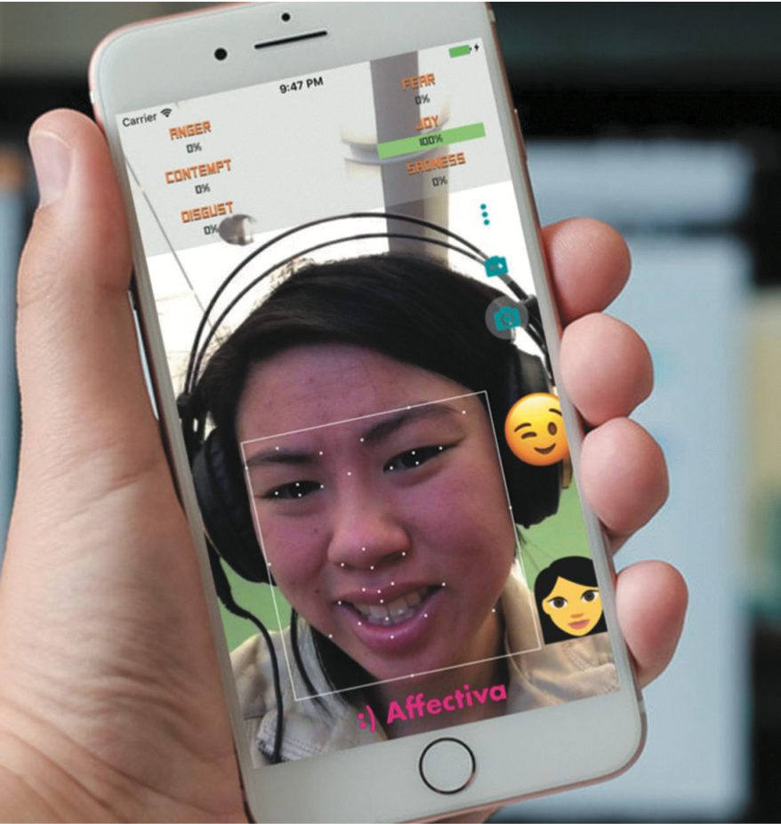
Facial coding using Affdex software

Slide 31
How is this emotional data used?
If user screws up their face when an ad pops up -> feel disgust
If start smiling -> they are feeling happy
Website can adapt its ad, movie storyline or content to match user’s emotional state
If system used in a car it might detect an angry driver and suggest driver takes a deep breath
Eye-tracking, finger pulse, speech and words/phrases also analysed when tweeting or posting to Facebook

Slide 32
Indirect emotion detection
Also used more to infer or predict someone’s behaviour
e.g. determining a person’s suitability for a job or how they will vote at an election
Do you think it is ethical that technology can read your emotions from your facial expressions or from your tweets?

Slide 33
Persuasive technologies and behavioural change
Interactive computing systems designed to change people’s attitudes and behaviours (Fogg, 2003)
A diversity of techniques now used to change what they do or think
Pop-up ads, warning messages, reminders, prompts, personalized messages, recommendations, Amazon 1-click
Commonly referred to as nudging
Notes:
33

Slide 34
Nintendo’s Pocket Pikachu
Was developed to change bad habits and improve well being
Designed to motivate children to be more physically active on a regular basis
owner of the digital pet that ‘lives’in the device is required to walk, run, or jump
If owner does not exercise the virtual pet becomes angry and refuses to play anymore
Notes:
34
This use of positive rewarding and sulking can be a powerful means of persuasion, given that children often become emotionally attached to their virtual pets, especially when they start to care for them.

Slide 35
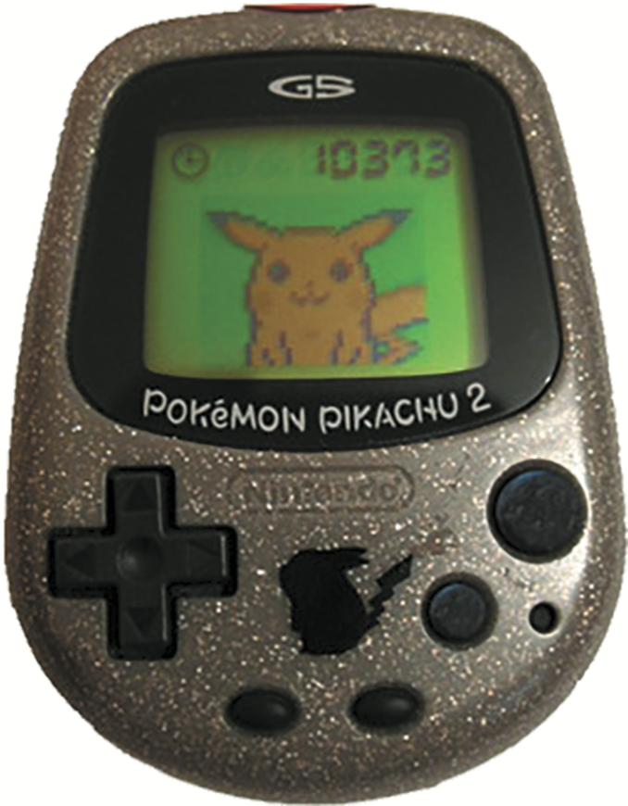
How effective?
Can interactive technologies that monitor, nag, or behave like a human keep them interested in looking after it and in doing so fitter, themselves?
How does looking after a virtual pet change a child’s behaviour?
Emotional attachment
Happy Pokemon makes them feel good
Sulking Pokemon makes them feel bad
Notes:
35

Slide 36
Tracking devices
Mobile apps designed to help people monitor and change their behaviour (e.g. fitness, sleeping, weight)
Can compare with online leader boards and charts, to show how they have done in relation to their peers and friends
Also apps that encourage reflection that in turn increase well-being and happiness

Slide 37
Sustainable HCI
Focus on designing tech interventions to help people reduce their energy consumption
An effective technique is to provide householders with feedback on their consumption
Simple infographics and emoticons are often most powerful
Encourage people to reflect and see what they can change to reduce their energy consumption
Peer pressure and social norms are also powerful methods

Slide 38
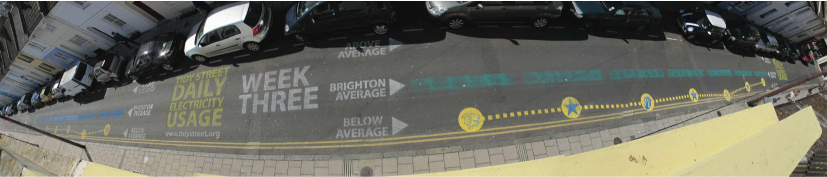
The Tidy Street project
Large-scale visualization of the street’s electricity usage
stencilled display on the road surface using chalk
provided real-time feedback that all could see change each day
reduced electricity consumption by 15%
Bird and Rogers, 2010)

Slide 39
Phishing scams
Web used to deceive people into parting with personal details
e.g. Paypal, eBay, and won the lottery letters
Allows Internet fraudsters to access their bank accounts and draw money from them
Many vulnerable people fall for it
The art of deception is centuries old but internet allows ever more ingenious ways to trick people
Notes:
39

Slide 40
Anthropomorphism
Attributing human-like qualities to inanimate objects (e.g. cars, computers)
Well known phenomenon in advertising
dancing butter, drinks, breakfast cereals
Much exploited in human-computer interaction
make user experience enjoyable, motivating, make people feel at ease, reduce anxiety
Furnishing technologies with personalities can make them enjoyable to interact with
Notes:
40

Slide 41
Which message you prefer?
As a welcome message:
“Hello Chris! Nice to see you again. Welcome back. Now what were we doing last time? Oh yes, exercise 5. Let’s start again.”
“User 24, commence exercise 5.”
Notes:
41

Slide 42
Which do you prefer?
Feedback when user gets something wrong:
“Now Chris, that’s not right. You can do better than that. Try again.”
“Incorrect. Try again.”
Is there a difference as to what you prefer depending on type of message? Why?
Notes:
42

Slide 43
Evidence to support anthropomorphism
Reeves and Naas (1996) found that computers that flatter and praise users in education software programs -> positive impact on them
“Your question makes an important and useful distinction. Great job!”
Students were more willing to continue with exercises with this kind of feedback
Notes:
43

Slide 44
Robot-like or cuddly?
Which do you prefer and why?
Aibo
The Haptic Creature
Notes:
Most people like stroking pets and cuddly toys and so will as likely want to stroke pet robots. However, because they look and feel like the real thing some people may find them a bit creepy. A motivation for making robot pets cuddly is to enhance the emotional experience people have through using their sense of touch. For example, the Haptic Creature is a robotic device that mimics a pet that might sit in your lap, such as a rabbit or a cat (Yohanan et al, 2008). It is made up of a body, two ear-like appendages, a breathing mechanism, a purring mechanism, and a warming element. These enable it to detect the way it is stroked and to respond accordingly. When it is placed in a human’s lap and that person strokes its fur, it might consider this as a pleasing interaction and will update its emotional state to reflect happiness. This then triggers quick rhythmic breathing that causes its ribcage to press against the human’s hand. It also stiffens its ears and makes a gentle purring-like vibration. Note how the rabbit has no eyes, nose or mouth. These were deliberately left off to see how people respond to it primary through touch.
44

Slide 45
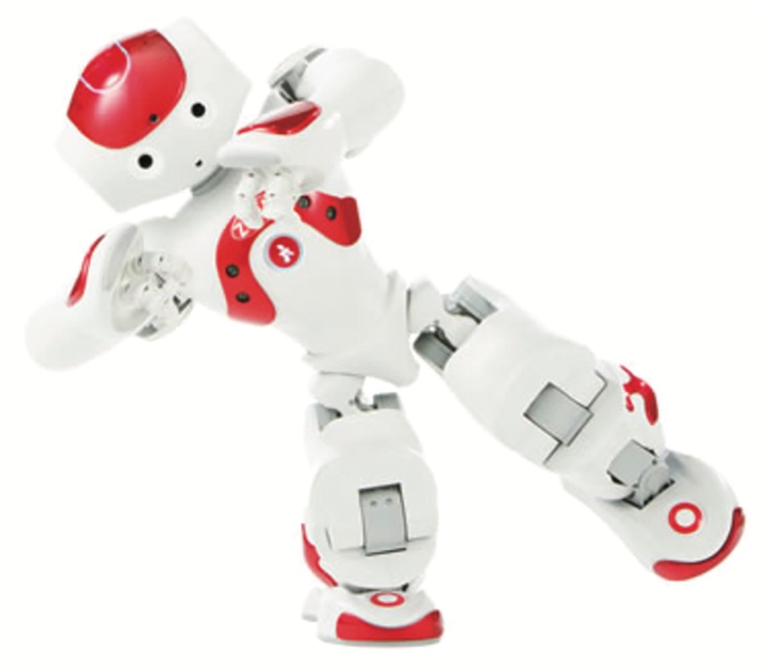
Is it OK for senior people to develop an emotional attachment with the robot Zora?

Slide 46
Summary
Emotional aspects of interaction design are concerned with how to facilitate certain states (e.g. pleasure) or avoid reactions (e.g. frustration)
Well-designed interfaces can elicit good feelings in people
Aesthetically pleasing interfaces can be a pleasure to use
Expressive interfaces can provide reassuring feedback to users
Badly designed interfaces make people frustrated, annoyed, or angry
Emotional AI and affective computing use AI and sensor technology for detecting people’s emotions through analyzing their facial expressions and conversations
Emotional technologies can be designed to persuade people to change their behaviors
Anthropomorphism is the attribution of human qualities to objects
Increasingly robots are being used as companions in the home
Notes:
46

Slide 47
You should now...
Be able to define the impact of emotion on the user experience
Be able to explain the difference between expressive and annoying user interfaces
Be able to explain how technology can be designed to change people’s attitudes and behavior
Be able to define and provide an example of anthropomorphism

